Slide 1
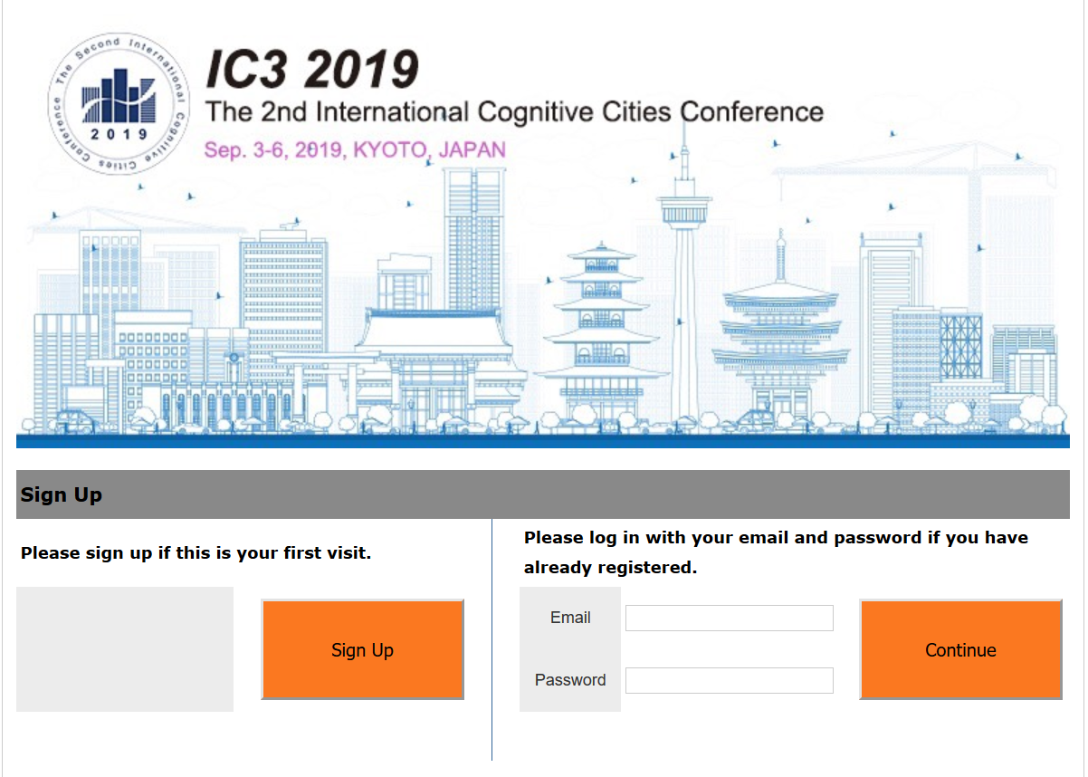
IC3 2019 Registration Tutorial
Please click “Sign Up” before your registration.

Slide 2
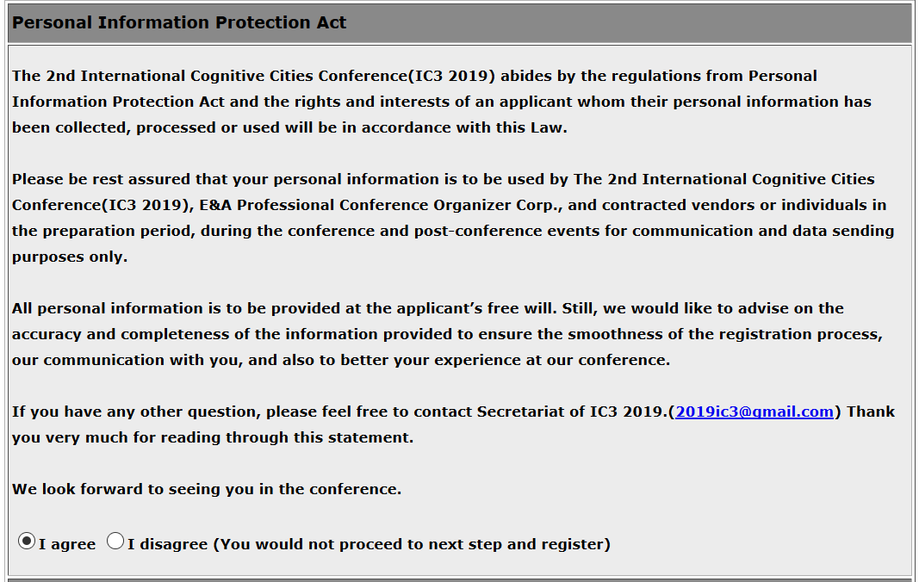
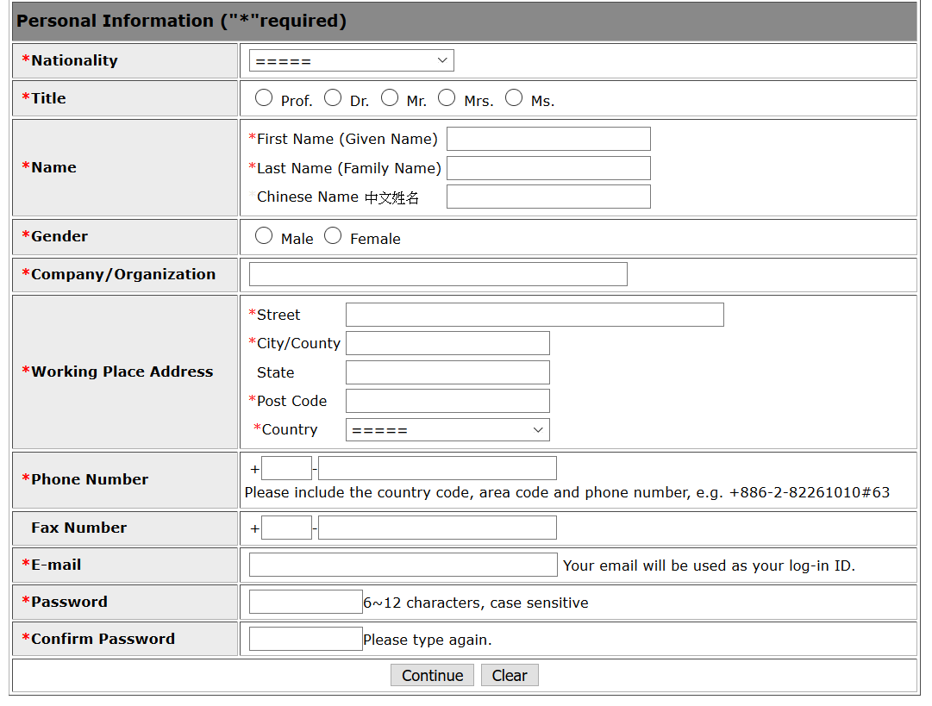
IC3 2019 Registration Tutorial
Your personal information will only be used for contact purpose. Please click “I agree” to proceed with the registration.
Please fill in the personal information.

Slide 3
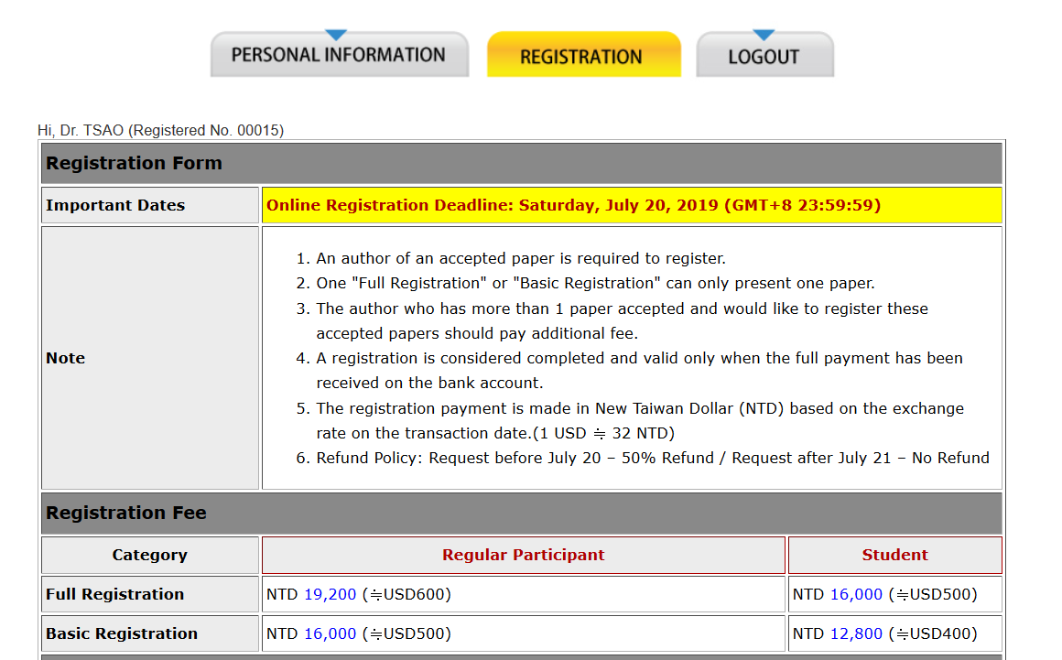
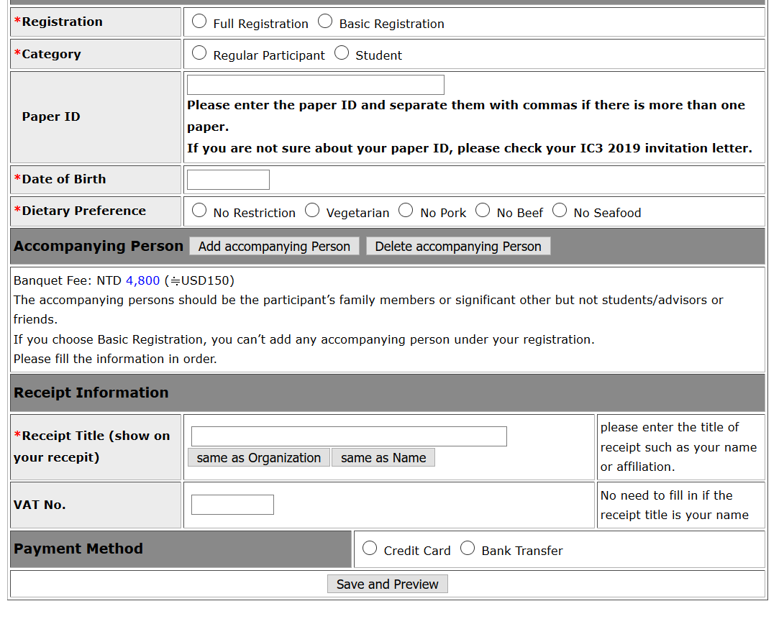
IC3 2019 Registration Tutorial
After signing up, the log-in information will be sent to you. Meanwhile, the system will guide you toward the registration page.
Please fill in the registration information including the paper ID if your paper is accepted.

Slide 4
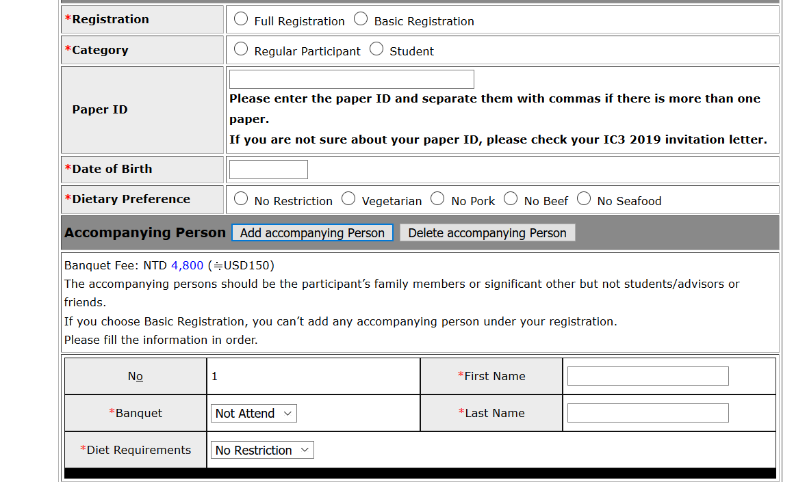
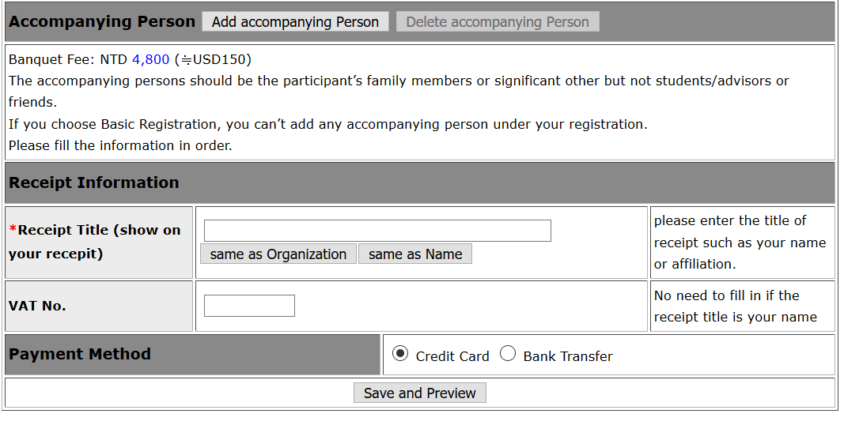
IC3 2019 Registration Tutorial
If the accompanying person is going to attend the banquet, please click “Add Accompanying Person”.
Please choose payment method and click “Save and Preview” after you fill in all the information.

Slide 5
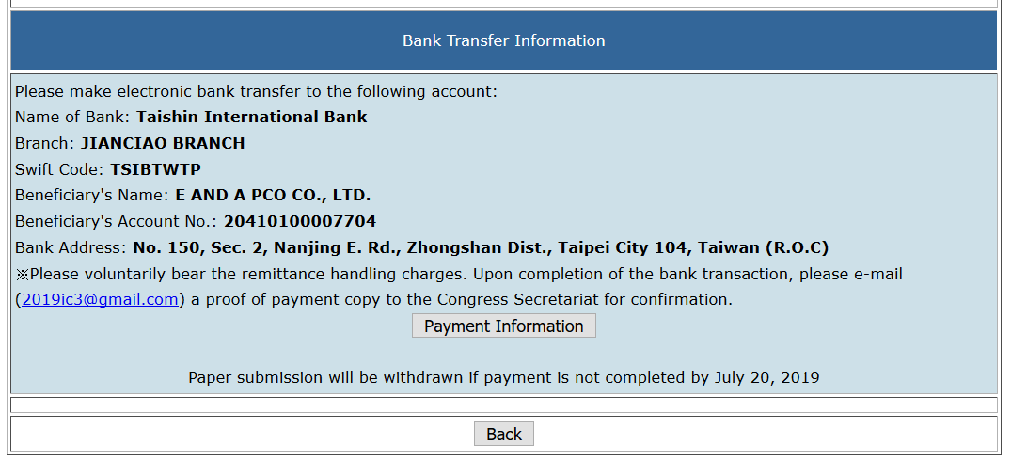
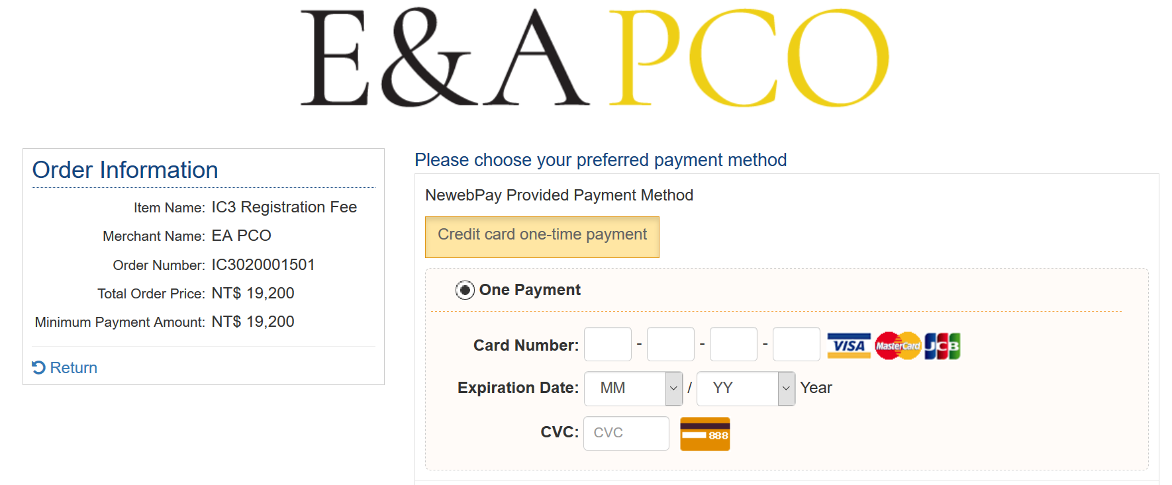
IC3 2019 Registration Tutorial
If you choose wire transfer payment, the account information will be shown on the system. You can click “Payment Information” to get a reminder email. Please email your proof of payment copy to the secretariat for confirmation after you complete the payment.
If you choose credit card payment, please click “Continue to Pay”. The system will guide you toward the payment gateway.

